Slide 1
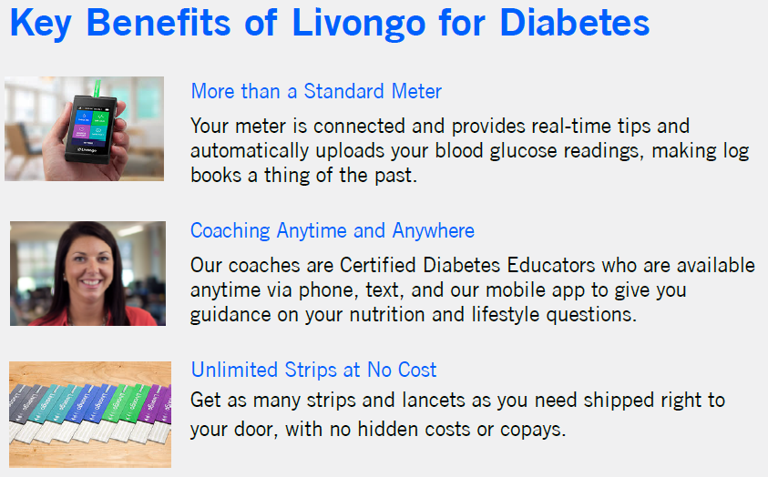
Livongo – Diabetes Management
Livongo is a holistic disease management program that provides management solutions for diabetes, hypertension, and obesity.

Slide 2
Livongo Pricing
Pricing = $67
Per Participant Per Month (PPPM)
There is no Minimum participation requirement
Communications will be branded for the SNJRHIF
Livongo provides an estimated $83 savings per participant per month, although there is no guaranteed ROI

