Slide 1

Wellness Coaches – Healthy Ways Platform
  Wellness Coaches offers a virtual platform that provides one-on-one personalized support for employees to improve health risks and engage in valuable health & wellness resources
  Group-level reporting on utilization and member engagement level and assessment of group risks such as
    Obesity
    Sleep
    Stress management
    Financial Distress
  Core Capabilities
  Connect with Coach via instant message
  Self-guided wellness programs
  Library of Resources
  Additional Upgraded Capabilities
  Employee Incentive Management
  Wearable device synching
  Customizable communications on platform
  Biometric Screening Reporting
Platform Dashboard Preview

Slide 2
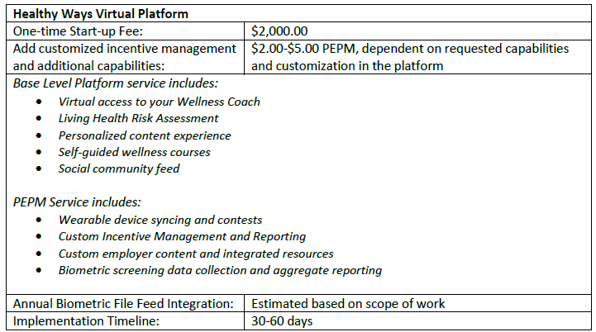
Wellness Coaches Healthy Ways Platform
Annual Cost
Start-up Fee | $2,000.00
PEPM | $2.00
Enrollment | 409
Annual Total | $ 11,816.00

